Slide 1
Matrix Algebra

Slide 2
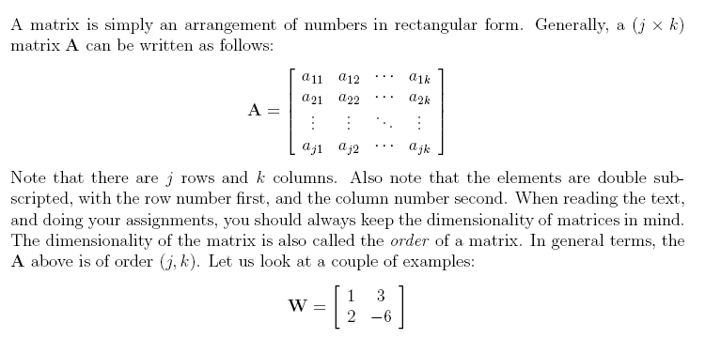
Definition of Matrices & Vectors

Slide 3
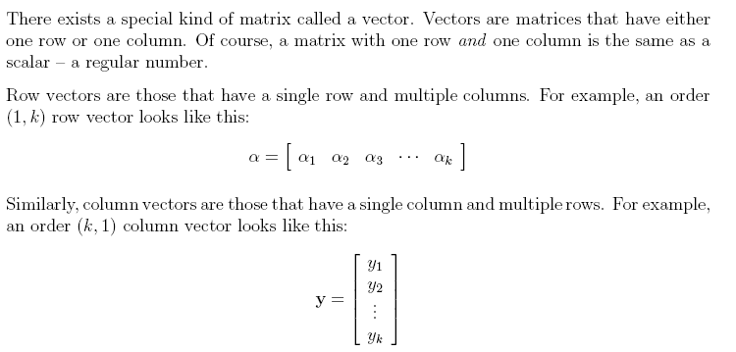

Slide 4
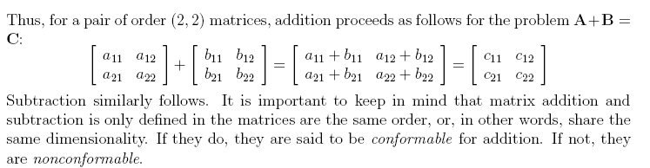
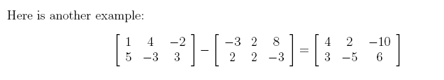
Matrix Addition & Subtraction

Slide 5

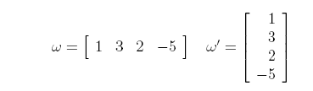

Slide 6
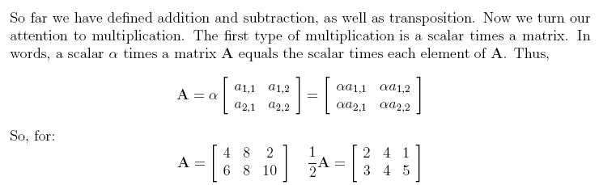

Matrices & Multiplication

Slide 7
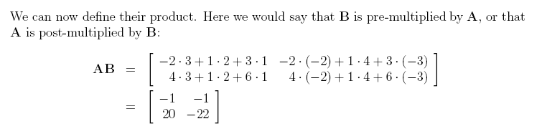
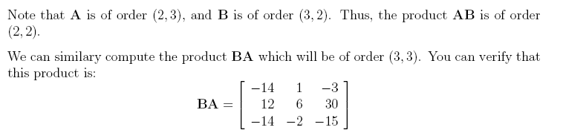

Slide 8
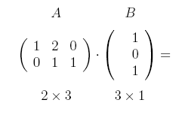
Can the following two matrices be multiplied?
Yes! Because their sizes are compatible i.e. the 2 numbers in the middle (3) are the same for both matrices.

Slide 9
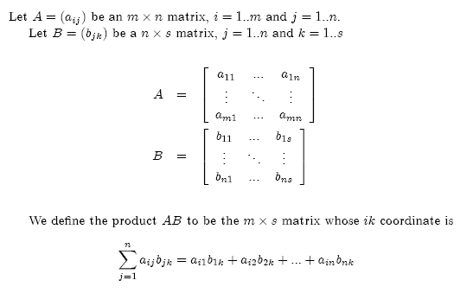
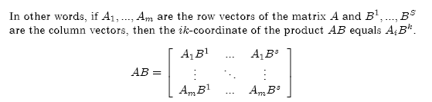

Slide 10
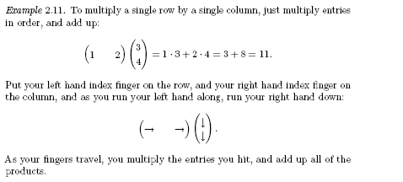

Slide 11

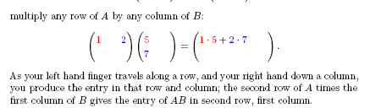

Slide 12
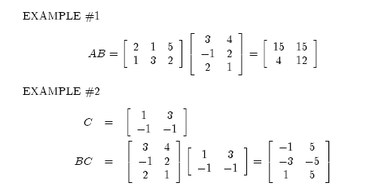

Slide 13
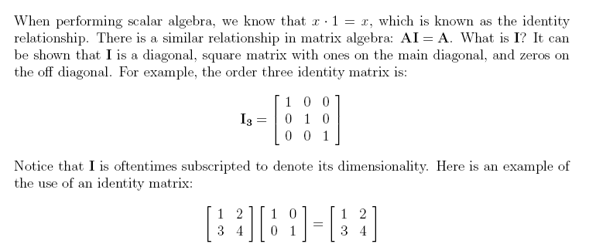
Special Matrices

Slide 14
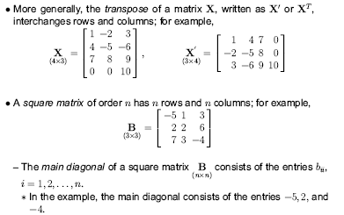


Slide 15
Boolean Matrices
Boolean matrices are matrices with only 0’s and 1’s as entries. We can define an operation of Boolean matrix multiplication A x B on Boolean matrices using Boolean multiplication and Boolean addition instead of regular multiplication and addition. These are defined as:

Slide 17
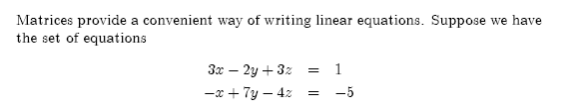
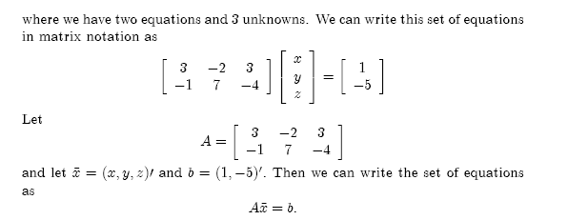
Representing a System of Linear Equations

Slide 18
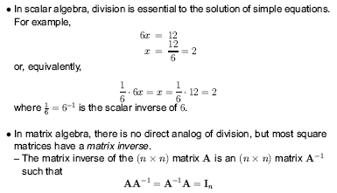
Matrix Inversion

Slide 19
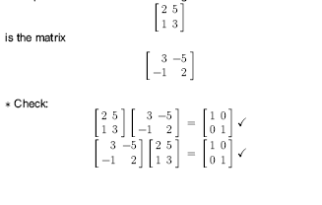
Example:
The inverse of the matrix

Slide 20
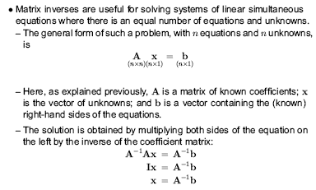

Slide 21
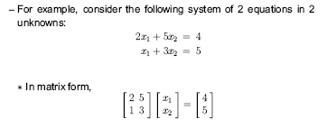
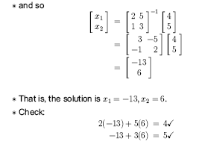

Slide 22


How to find the inverse of a 2x2 matrix

Slide 23
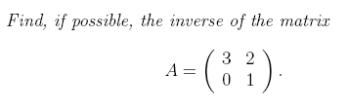
Solution:

Slide 24
Exercise: Find, if possible, the inverse of

Slide 26
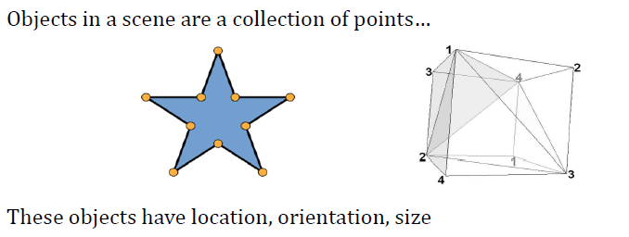
Matrices in Computer Graphics

Slide 27
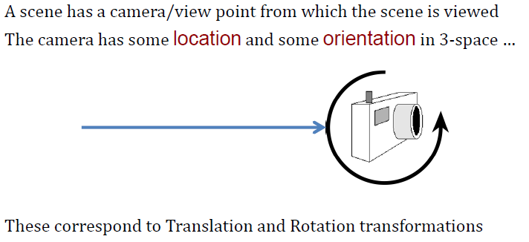

Slide 28
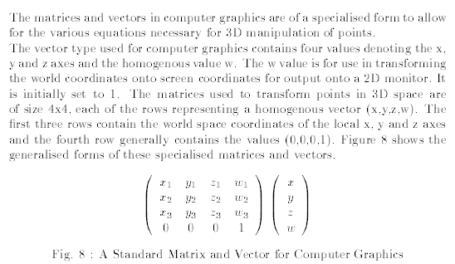

Slide 29
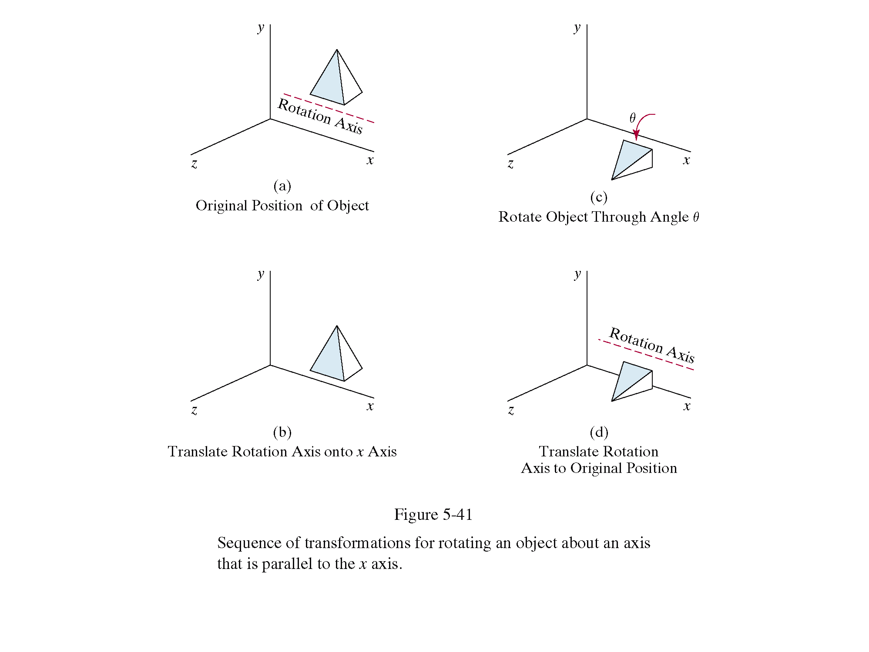
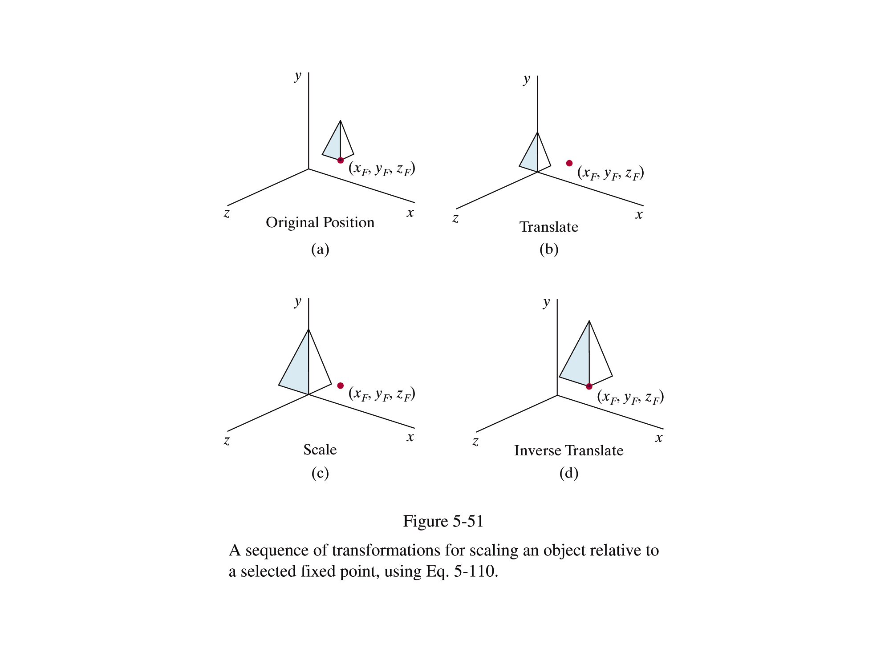
Transformations
In graphics, once we have an object described, transformations are used to move that object, scale it and rotate it

Slide 30
Translation
Simply moves an object from one position to another
x_{new} = x_{old} + dx y_{new} = y_{old} + dy
y
6
5
4
3
2
1
0
1
2
3
4
5
6
7
8
9
10
x
Note: House shifts position relative to origin

Slide 31
Scaling
Scalar multiplies all coordinates
WATCH OUT: Objects grow and move!
x_{new} = Sx × x_{old} y_{new} = Sy × y_{old}
y
6
5
4
3
2
1
0
1
2
3
4
5
6
7
8
9
10
x
Note: House shifts position relative to origin

Slide 32
Rotation
Rotates all coordinates by a specified angle
x_{new} = x_{old} × cosθ – y_{old} × sinθ
y_{new} = x_{old} × sinθ + y_{old} × cosθ
Points are always rotated about the origin
y
6
5
4
3
2
1
0
x
1
2
3
4
5
6
7
8
9
10

Slide 33
Homogeneous Coordinates
A point (x, y) can be re-written in homogeneous coordinates as (x_{h}, y_{h}, h)
The homogeneous parameter h is a non- zero value such that:
We can then write any point (x, y) as (hx, hy, h)
We can conveniently choose h = 1 so that (x, y) becomes (x, y, 1)

Slide 34
Why Homogeneous Coordinates?
Mathematicians commonly use homogeneous coordinates as they allow scaling factors to be removed from equations
We will see in a moment that all of the transformations we discussed previously can be represented as 3*3 matrices
Using homogeneous coordinates allows us use matrix multiplication to calculate transformations – extremely efficient!

Slide 35
Why is this useful?
First, for software engineering reasons it is useful to have a common data-type by which we can represent general transformations e.g. For passing as arguments between programmed functions. Second, and more significantly, we are able to multiply 3x3 matrices together to form more sophisticated compound matrix transformations that are representable using a single 3x3 matrix e.g. We can multiply rotation and translation matrices to derive a 3x3 matrix for rotation about an arbitrary point – we are not restricted to rotation about the origin as before.

Slide 36
Homogeneous Translation
The translation of a point by (dx, dy) can be written in matrix form as:
Representing the point as a homogeneous column vector we perform the calculation as:

Slide 37
Remember Matrix Multiplication
Recall how matrix multiplication takes place:

Slide 38
Homogenous Coordinates
To make operations easier, 2-D points are written as homogenous coordinate column vectors
Translation:
Scaling:

Slide 39
Homogenous Coordinates (cont…)
Rotation:

Slide 40
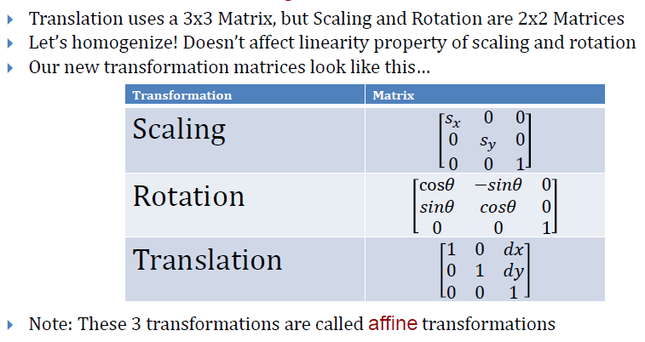
Transformations Homogenized

Slide 41
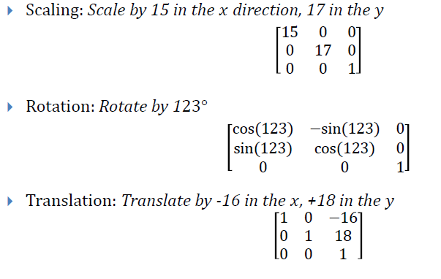
Examples

Slide 42

Example - Scaling
The unit square with vertices (1,1), (2,1), (2, 2) and (1, 2) is scaled about the origin by factors of 4 in the x-direction and 2 in the y-direction. Then, we have
So the image is a square with vertices (4, 2), (8,2), (8,4) and (4, 4).

Slide 43
Example

Slide 45
Example 1 - Rotation

Slide 46
Solution
Using the layout given for rotation given above: (Note: clockwise = counter clockwise

Slide 48
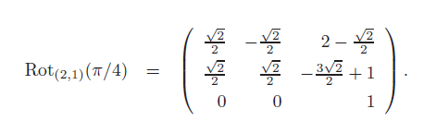
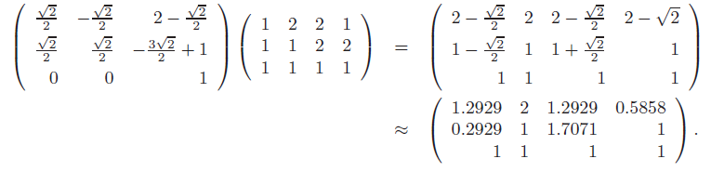
Example 2 - Rotation

Slide 49
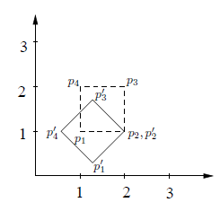
Rotation about p2

